Slide 1








Housing Price Analysis
Tools: Python, NumPy, Pandas, Seaborn, Matplotlib
By Tanya Gera

Slide 2
Objective:
Analyze housing dataset (1460 rows, 81 features)
Clean missing values & handle outliers
Perform EDA with Pandas, NumPy, Seaborn
Discover factors affecting SalePrice

Slide 3
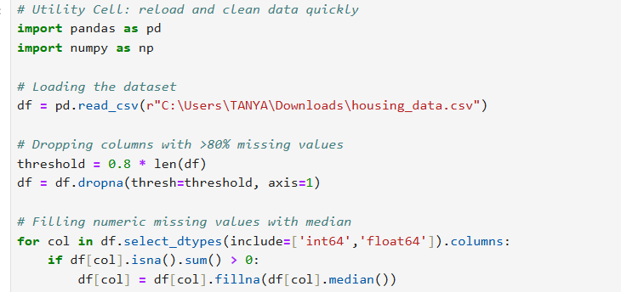
Data Cleaning
Dropped columns with >80% missing data
Imputed missing values (median for numeric, mode for categorical)
Removed duplicates → Final dataset: (1460 × ~79)
Verified with .info() and .describe()

Slide 4
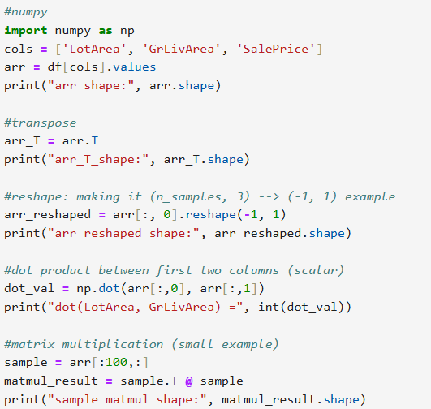
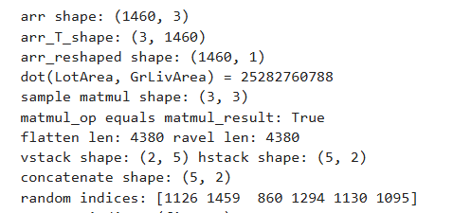
NumPy Analysis
Array operations: transpose, reshape, flatten
Matrix multiplication, dot product, broadcasting
Random sampling & fancy indexing

Slide 5
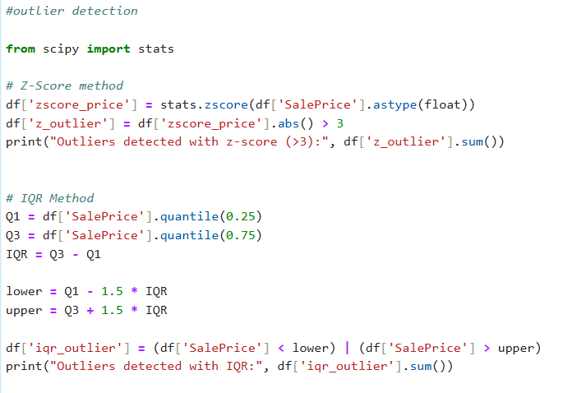
Outlier Detection
Z-score (>3) → 22 outliers
IQR (1.5× rule) → 61 outliers
Boxplot confirmed extreme high-price houses (>400k)

Slide 6
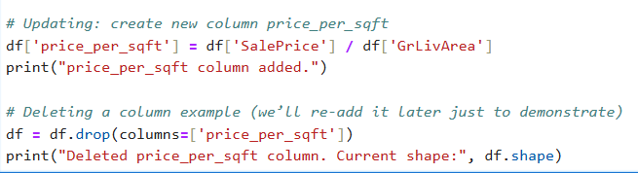
Feature Engineering
New column: price_per_sqft
Extracted SaleYear, SaleMonth from dates
Added rolling average (12-month) for SalePrice
Shifted SalePrice (lag feature) to track trends
Integrated a simple Python logger to record progress and ensure traceability throughout the workflow

Slide 7
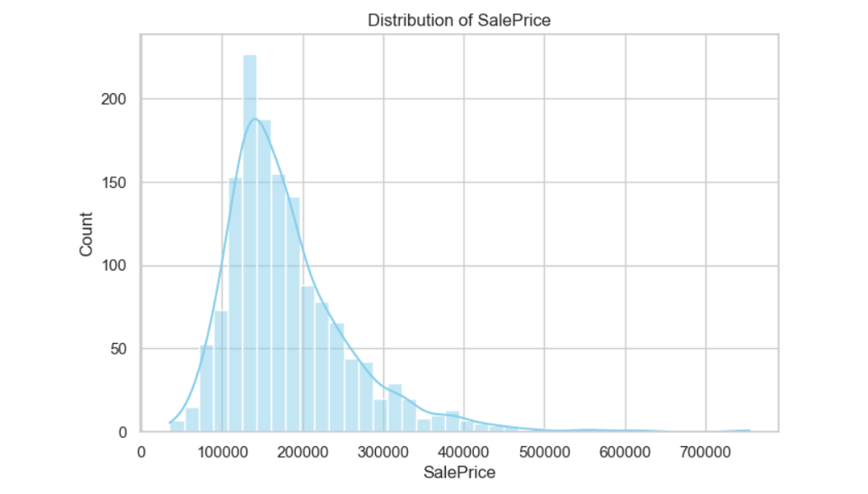
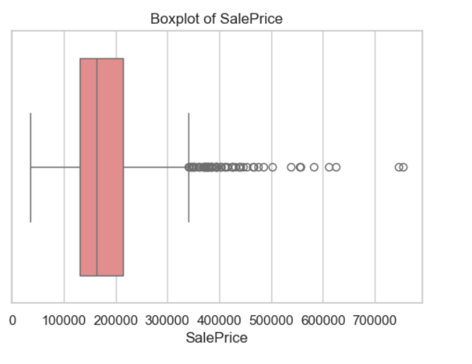
SalePrice Distribution
Distribution is right-skewed
Most houses between 120k–200k
Outliers up to 755k

Slide 8
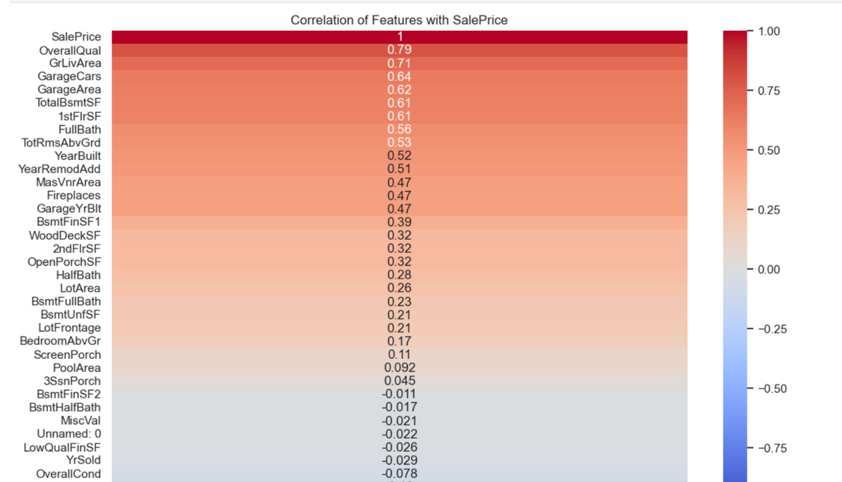
Correlation Analysis
Top correlated features with SalePrice:
OverallQual (0.79)
GrLivArea (0.71)
GarageCars, TotalBsmtSF
LotArea shows weak correlation

Slide 9
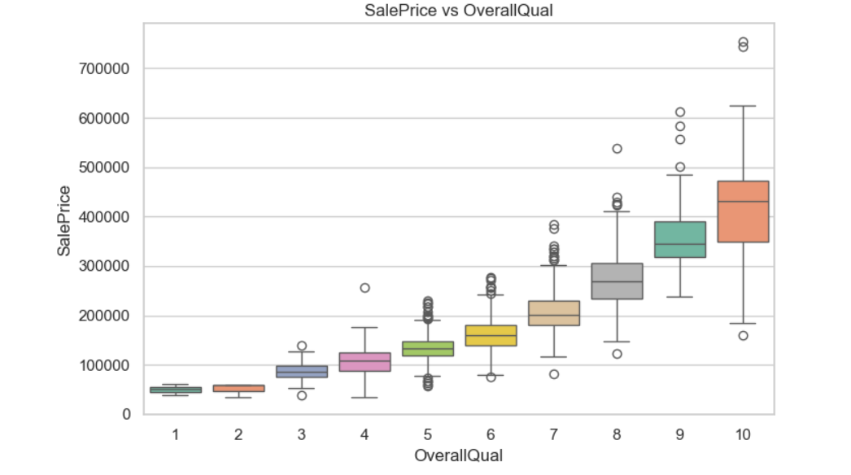
SalePrice vs Features
OverallQual: Higher quality = higher price
GrLivArea: Strong linear relationship
LotArea: Weak trend, many outliers

Slide 10
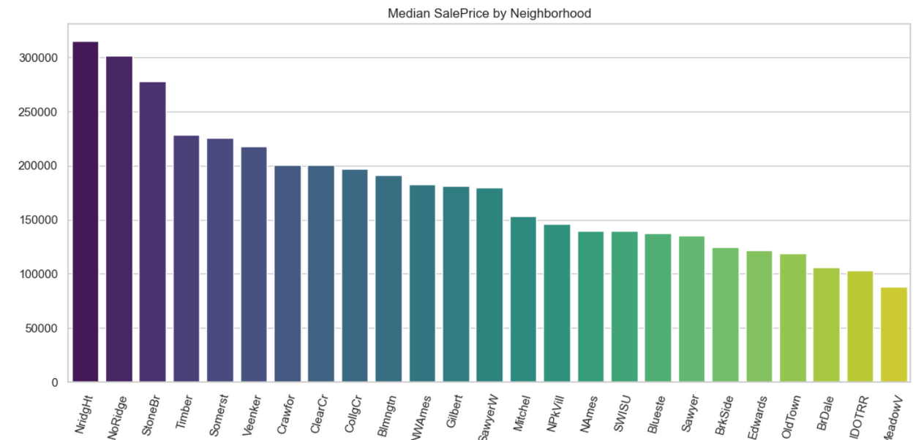
Neighborhood Analysis
Premium areas: NoRidge, NridgHt, StoneBr
Cheaper areas: MeadowV, IDOTRR
Location is a key driver of prices

Slide 11
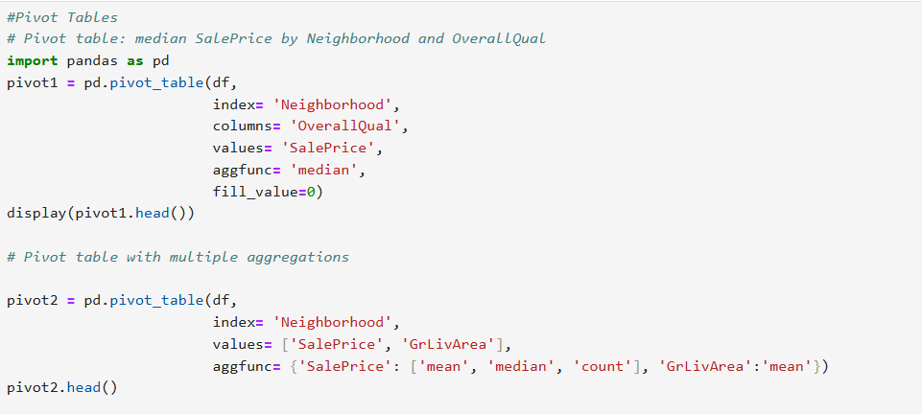
Pandas Operations
Groupby + Pivot tables (multi-aggregation)
Joins & merges with lookup tables
String ops & regex for data cleaning

Slide 12
Key Insights
House quality (OverallQual) and living area (GrLivArea) are the biggest price drivers.
Neighborhood strongly influences value differences.
Outliers represent premium, valid properties — not data errors.
Time trend (2006–2010) shows smooth rolling mean indicating stable pricing patterns

Slide 13
Conclusion
“From raw data to insights — a complete exploratory analysis pipeline.”
Complete EDA pipeline: Cleaning → Analysis → Insights
Applied NumPy, Pandas, Seaborn, Matplotlib effectively
Strong foundation for predictive modeling (Linear Regression / Random Forest)

Slide 14
Thank you,
Nexthikes

